Slide 1
AVRO POC
©2015 ITC Infotech. All Rights Reserved.

Slide 2
Basic Flow of the POC
Sample CSV File
Convert to .avro
Schema Generation
validation
Applying Business Logic
©2015 ITC Infotech. All Rights Reserved.

Slide 3
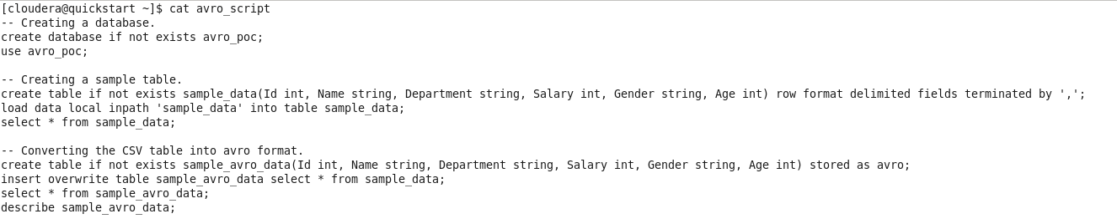
Step-0
As we don’t have any direct avro file, here we create an simple CSV file with below details and convert it to avro file.
EmpID, Ename, Department, Salary, Gender, Age
Inserting the data into table (sample table)
Creating an avro table and loading the data form the “sample table”.
Step-1
Extracting the schema from the .avro file to perform the validation.
©2015 ITC Infotech. All Rights Reserved.

Slide 4
Step-2
Structure Validation
Validating the input avro file based on the schema provided by the client/customer, i.e. comparing the given schema with the extracted schema along with the field names and data types.
Scenario-1
If the input avro file has 6 fields and the schema provided by client/customer has 4 fields
Secnario-2
If the input avro file has 4 fields and the schema provided by client/customer has 6 fields
Scenario-3
If all the field are matched but there is any mismatch data types.
Solution
Generate an avro schema form the input avro file.
Create an avro schema with the schema provided by client/customer.
Comparing both schema using shell script for any field or data type mismatch. If there are any mismatches – break. i.e. the file or the schema is invalid.
Else we can proceed further.
©2015 ITC Infotech. All Rights Reserved.

Slide 5
Step-3
validate number/decimal format.
Finding the NULL value in that particular column i.e. if it returns NULL it is not valid.
Step-4
validate some of the must attributes data.
Step-5
Finally applying some business rules on the data using hive.
©2015 ITC Infotech. All Rights Reserved.

Slide 6
Schema file
Input avro file
Generate an avro schema
Generate an avro schema
compare
Failed
Check the given file & schema
Success
Proceed with further validation
©2015 ITC Infotech. All Rights Reserved.

